Slide 1


Slide 2
University of Barishal Department of History,5th batch PowerPoint Slide - 2024 Dear MD Irfan sir, Assistant professor andChairman, Department of CSE, University of Barishal . Sub : Group Slide by PowerPoint and MS word Group : 2 Mohammad Sakib molla Ajoy Kumar Mondal Sarder Ashikuzzaman Mostafizur pankoj roy

Slide 3
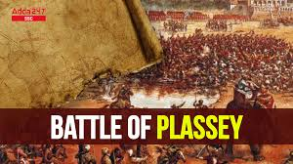
The Battle of Plassey

Slide 4
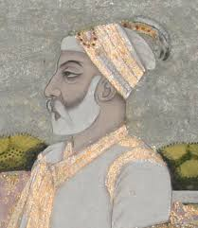
THE RULE OF ALIBARDI KHAN
Alivardi Khan ruled Bengal from 1740 to 1756. He was a competent and strong ruler, known for defending Bengal against external threats, especially the Marathas.

Slide 5
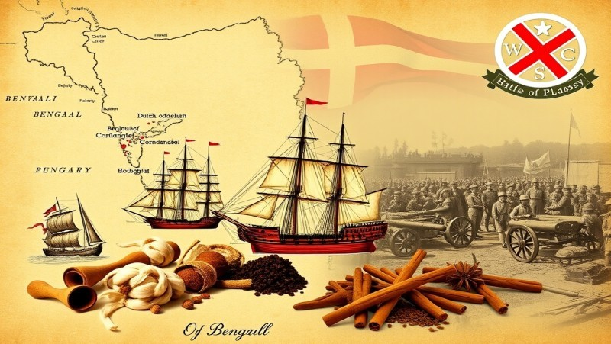
BRITISH ,PORTUGUESE AND DUTCH FREE TRADE POLICY
The British, Portuguese, and Dutch implemented free trade policies in India to expand their commercial interests, establishing trading posts and treaties with local rulers. Over time, these policies led to British dominance, overshadowing the earlier influences of the Portuguese and Dutch.

Slide 6
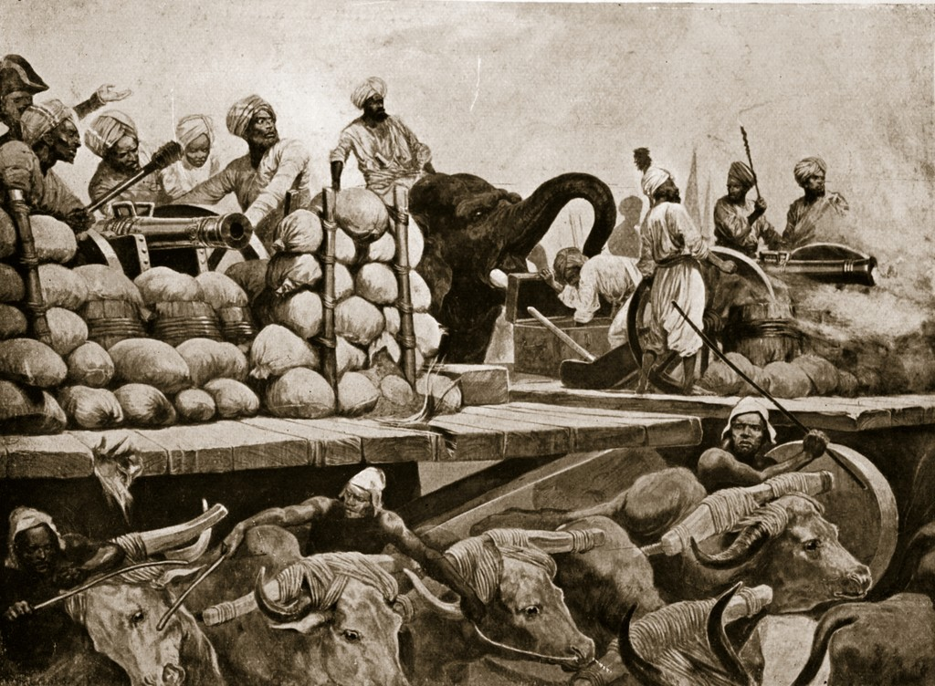
SHIRAZ ENTERFARENCE IN FREE TRADE
Siraj ud-Daulah's interference in free trade involved imposing heavy taxes on foreign traders and restricting their activities, particularly targeting the British East India Company. His actions aimed to assert control over Bengal's economy, leading to tensions that ultimately contributed to the decline of his reign.

Slide 7
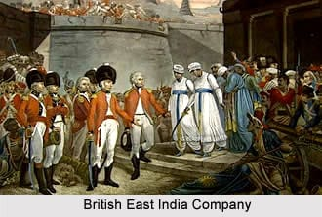
DETERIORATION OF RELATIONS WITH THE BRITISH
Relations between Siraj ud-Daulah and the British deteriorated due to increasing tensions over trade policies, taxation, and the British East India Company's expansionist ambitions. The conflict culminated in the 1757 Battle of Plassey, where the British ultimately defeated Siraj, leading to their dominance in Bengal.

Slide 8
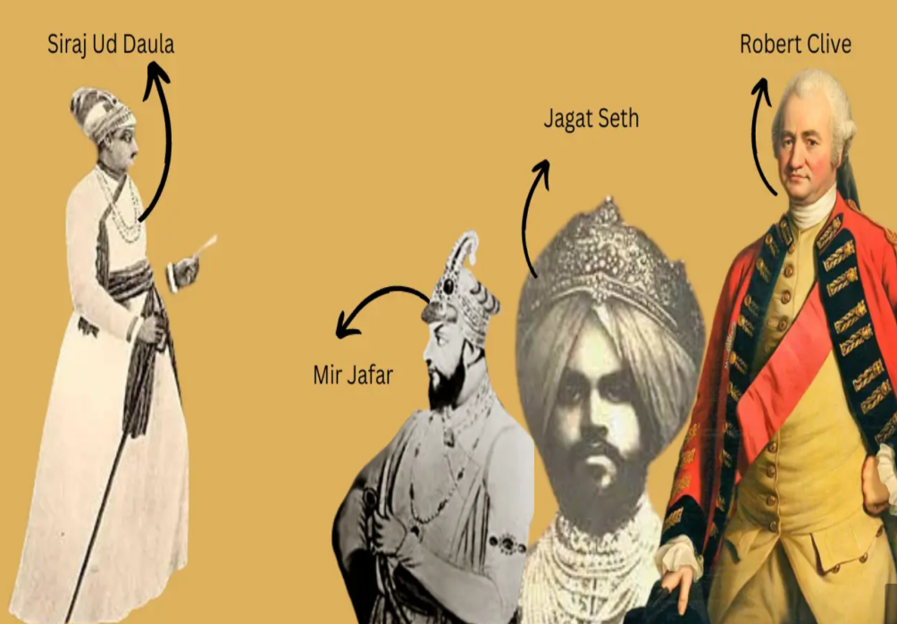
CONSPIRACY AGAINST THE NAWAB
A conspiracy against Nawab Siraj ud-Daulah was orchestrated by discontented Bengali nobility and the British East India Company, who sought to undermine his authority.

Slide 9
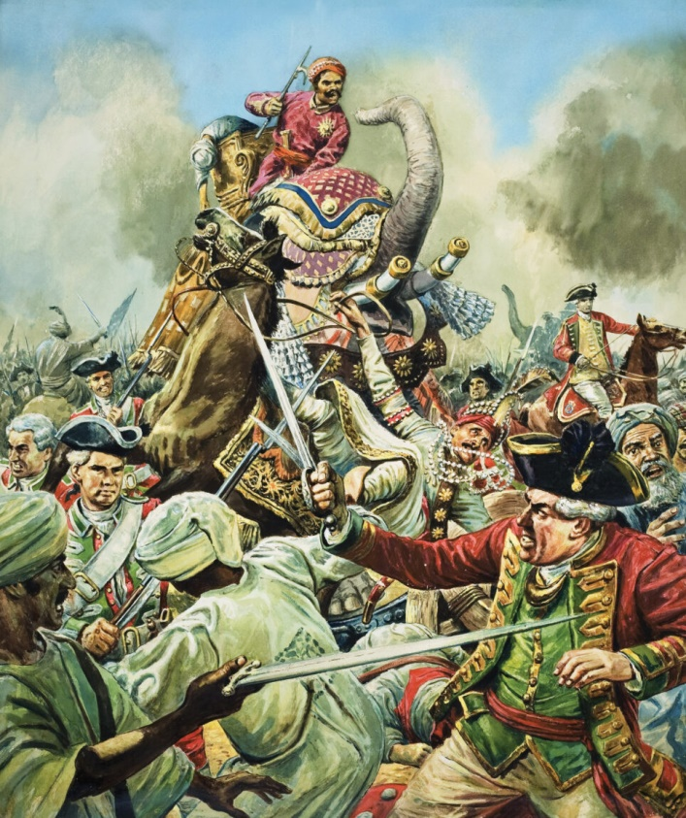
BATTLE DAY OF PALASHI
The Battle of Plassey took place on June 23, 1757, between the forces of Nawab Siraj ud-Daulah and the British East India Company.

Slide 10
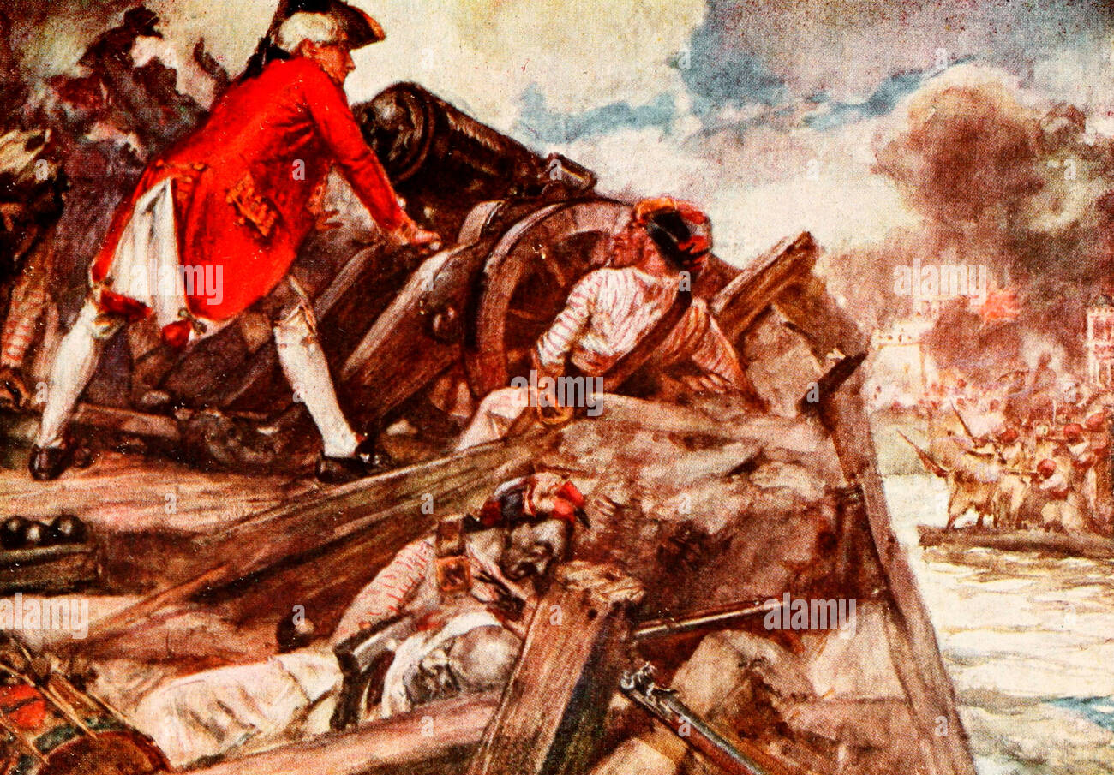
TREACHERY AND DEFEAT OF SUN
The treachery of key allies, including Mir Jafar, played a crucial role in the defeat of Nawab Siraj ud-Daulah at the Battle of Plassey

Slide 11

THANK YOU

